Slide 1

Insurance FUNdamentals: Tips and Terms in Ten minutes or less
What is a Peril and why does it matter?

Slide 2
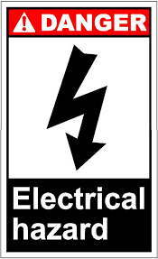
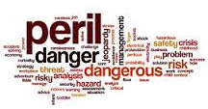

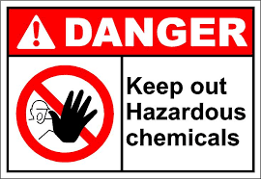
Insurance has its own language
Dictionary.com defines “Peril” as:
  1. exposure to injury, loss, or destruction; grave risk; jeopardy; danger

Slide 3
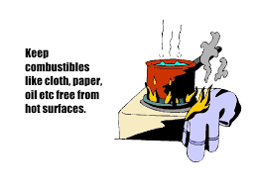
True….But….
When you are talking about insurance, a “peril” is:
  A cause of loss
A Peril is the cause of a loss; a hazard increases the chance of a peril or the chance of loss. When you underwrite or inspect, you are looking for hazards that are open and obvious (oily rags near combustible materials) . You want to remove the hazard to lower the risk of loss (peril of fire).

Slide 4
How does insurance define Peril?
Although Dictionary.com defines “Peril” as “exposure to risk….danger”, in insurance when we speak of “perils” we mean the trigger for coverage in the policy.
Named Peril language may look like this:
"We insure for direct physical loss to the property ...by a peril listed below, unless the loss is excluded..." (underlining added)
1. Fire or Lightning
2. Windstorm or hail. This peril does not include loss to property contained in a building, unless the direct force of wind or hail damages the building first.
3. Explosion
4. Theft
Notes:
Today we are going to focus on personal lines property, primarily homeowners. This language may not be the same as your policy, but it is probably similar. In the normal world, a peril is an exposure to danger—like a “no smoking” sign next to an oxygen tank that warns of the danger of explosion. In the normal world, perils are things you are warned about so you can avoid them. In our world, a “peril” is the cause of loss (fire, wind, explosion) that triggers coverage. It’s important to know what perils your policy covers so you can pay claims correctly or so you can underwrite to try and prevent the loss from occurring or possibly to eliminate coverage for a peril to prevent losses that can’t be managed with rating. There are generally two types of coverage—”named peril” and “open peril”. Named peril is our focus today for this discussion. With Named peril (as the name implies) you “name” or list the covered causes of loss (the Perils you cover). The cause of the loss has to be in the list in order for there to be coverage. For claims people, your first question could be “what happened” meaning “what was the cause of loss (the peril)” because the answer may quickly show that there was no coverage. For instance, given the perils in this example, if the insured says they had damage from a recent tornado, it appears to be a covered peril and the adjuster will need to gather more information to determine coverage—but, the first hurdle (a covered peril) seems to be met.

Slide 5
Why do I care?
Words are important, especially in insurance
If you are in claims, you need to know if your policy is “Named Peril”; if so, you need to look for those in determining coverage
If you are an agent, and you have a client who is concerned about a type of loss (for instance, “what if an airplane hits my house”), then you want to be able to show that peril in the policy
If you are an underwriter, you need to know the covered perils to help determine if you have options at renewal for frequency or severity problems—for instance, you may have added perils to the policy via an endorsement such as back up of sewer and drain. If the policy is otherwise acceptable, but has too many losses due to sewer backup, you may be able to engineer the risk by removing that coverage rather than nonrenewing.

Slide 6
Not all policies are created equal…
Remember, not all forms are the same. If you represent multiple companies as an agent, Co A may cover what Co B does not. Look for the perils.
If you work for the company, remember that forms are different. Generally, you may work with an HO, FO, DF etc. (lines or programs of insurance) and those may have a form 1, 2, 3, 4 or 5. All forms will have differences, and may have different perils. Before answering questions agents or clients might have, be sure to verify what line or program they are calling on, and what form they are covered by or offering to the insured.

Slide 7

Want to learn more?
Contact us today:
www.insurancetrainingsolutions.com
insurancetrainingsolutions@gmail.com
(608) 509-1452
https://www.facebook.com/InsuranceTrainingSolutions/?ref=aymt_homepage_panel

